Slide 1

IntelliQuest Coding & Leadership Hub
This presentation explores the design and development of our gamified coding quiz app, the IntelliQuest Coding & Leadership Hub, designed to empower developers of all skill levels.

Slide 2

Group Members:
Khadija Bint E Nadeem (23F-BSCS-27)
RAWZIA SAJID (23F-BSCS-31)
SYED AMMAD KHALID (23F-BSCS-103)
SYED ABU HURERA (23F-BSCS-131)
MUHAMMAD HAMZA (23F-BSCS-91)

Slide 3

INTODUCTION
Objective
Audience
Develop a gamified coding quiz app that encourages interactive learning and motivates students to practice their coding skills.
This app targets students, aspiring programmers, and individuals seeking a fun and engaging way to improve their coding abilities.

Slide 4
Addressing the Challenges of Coding Education
Lack of Engaging Coding Platforms
Difficulty in Practice
Traditional coding exercises can be repetitive and uninspiring, leading to a lack of motivation and engagement. .
Finding opportunities to consistently practice coding skills outside of formal classroom settings can be challenging.

Slide 5

The Importance and Scope of the IntelliQuest Coding & Leadership Hub
Categories
Difficulty Levels
The app offers coding categories, allowing users to focus on specific topic
Questions are tailored to different skill levels, providing a gradual learning curve for users of all backgrounds.
Leaderboard
The app features interactive leaderboards to promote friendly competition and encourage users to strive for excellence.

Slide 6
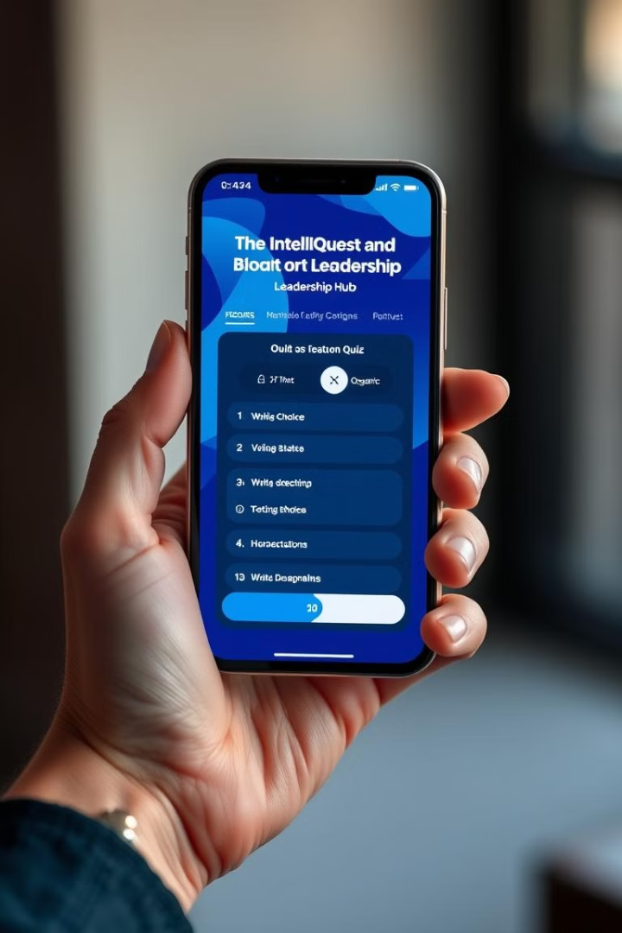



Key Features and Benefits of the IntelliQuest Coding & Leadership Hub
Gamified Quizzes
Interactive Quizzes
Interactive quizzes designed to challenge users' coding knowledge and reinforce learning through engaging gameplay.
Engaging quizzes covering various coding concepts and languages, tailored to different skill levels
Rewards
Earn points for answering quizzes correctly, motivating users and encouraging continued learning.

Slide 7
Software Tools and Development Methodology
GUI Platform
Programming Language
Database Platform
Qt Creator was utilized to develop the app's GUI, providing a robust IDE for designing an intuitive and visually attractive interface.
C++ was chosen for its performance and adaptability, ensuring solid code and seamless compatibility with the Qt framework.
MySQL was employed to efficiently manage and store data, offering a reliable database for user information, quiz data, and performance tracking.
.

Slide 8
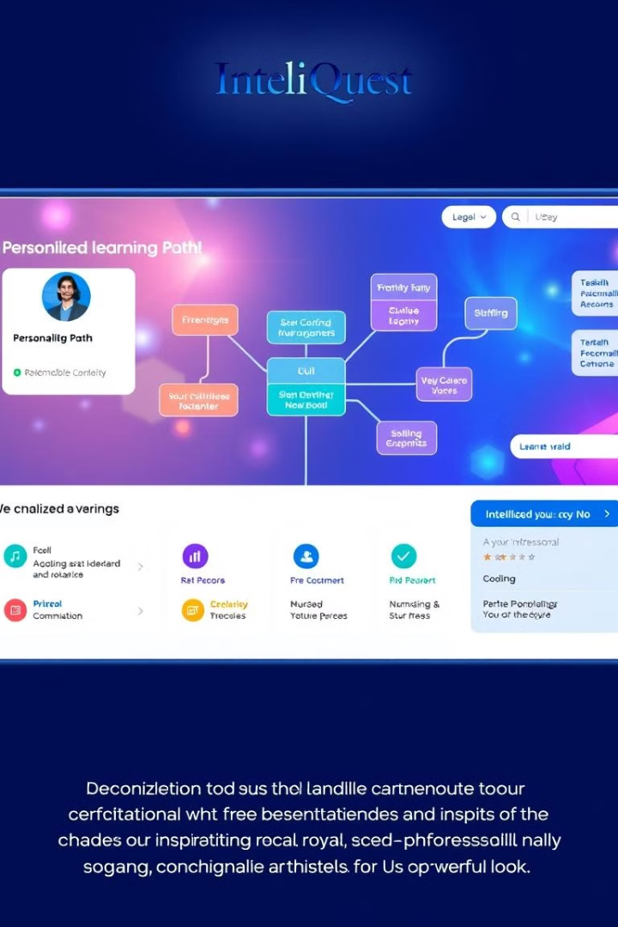
Future Vision: Enhancing the IntelliQuest Coding & Leadership Hub
1
API Integration
Plan to integrate API keys for dynamic question fetching from external sources, ensuring fresh and relevant content.
2
Comprehensive User History
Track full player history to provide personalized insights and recommendations for future learning paths.
3
Social Sharing Challenges
Introduce features like social sharing challenges, allowing users to compete with friends and collaborate on coding tasks.

Slide 9
References
This presentation has drawn inspiration from the following resources:
MySQL Connection Tutorial : https://youtu.be/dYTpKQjI7_k?si=SE2NtrrQpjmTD4lR
Working with Multiple Forms in Qt C++ : https://youtu.be/2mpF0ys3TJ0?si=11ieHCFx17Ms6mi5
Icons : Freepik.com
Error Correction : https://chatgpt.com

Slide 10
THANK YOU!

